Slide 1

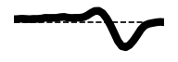
NEPR208 - Adaptation properties and mechanisms
Functional advantages in properties of a neural code and changes in those properties
What is adaptation?
Why do neural systems have a particular nonlinear and filter?
Why does the nonlinearity and filter change?
A hierarchy of systems
What biophysical mechanisms can cause adaptation?
Receptive Field
Spatiotemporal
Filter
Linear-Nonlinear (LN) Model
Time
Preferred
Visual feature

Slide 2
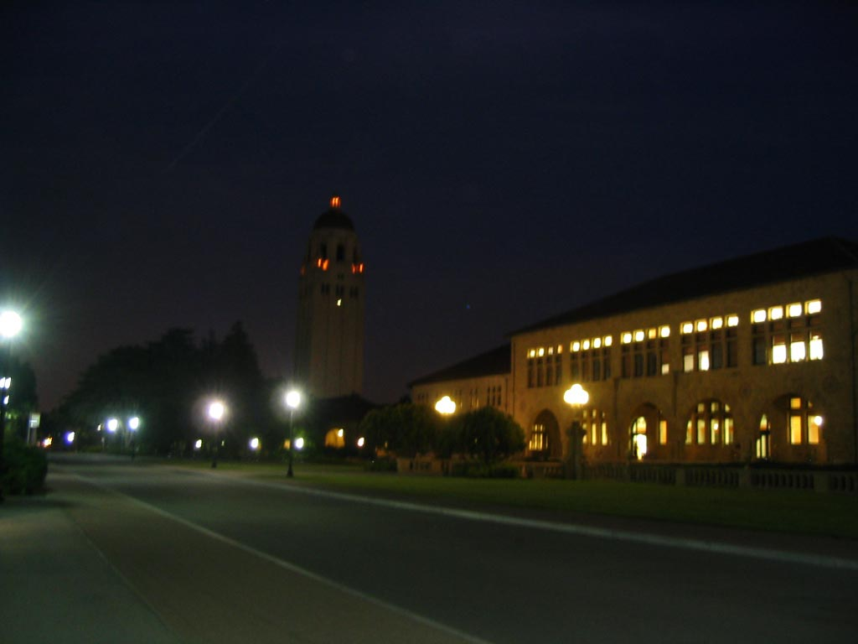
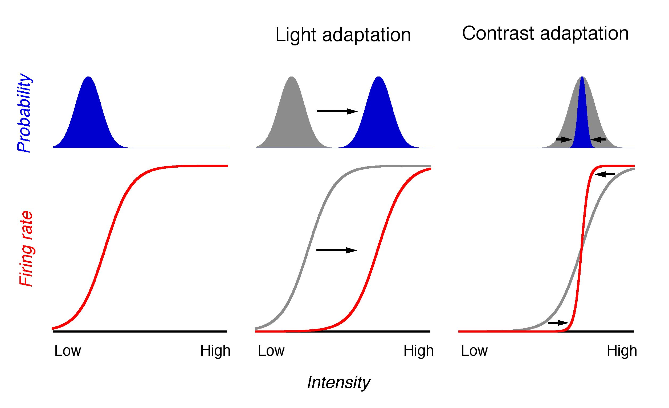
What happens when stimulus statistics change?
Intensity

Slide 3
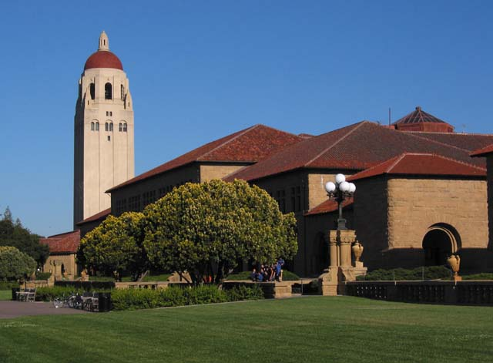
What happens when stimulus statistics change?
Intensity

Slide 4
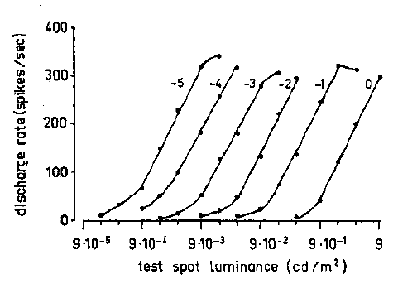
Ganglion cell response curves shift to the mean light intensity
Sakmann and Creuzfeldt, Scotopic and mesopic light adaptation in the cat’s retina (1969)
Notes:
Each of these curves show the response of a ganglion cell to a flashing test spot. Each curve is measured at a different background adapting intensity.

Slide 5
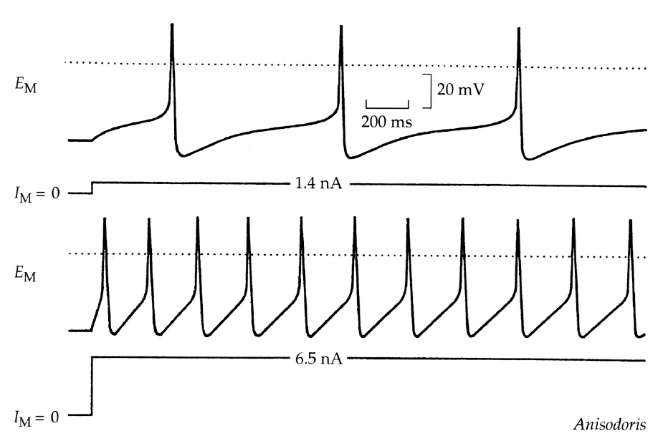
Neurons have a limited dynamic range
set by maximum and minimum output levels, and by noise

Slide 6
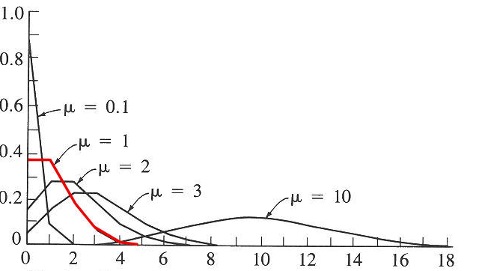
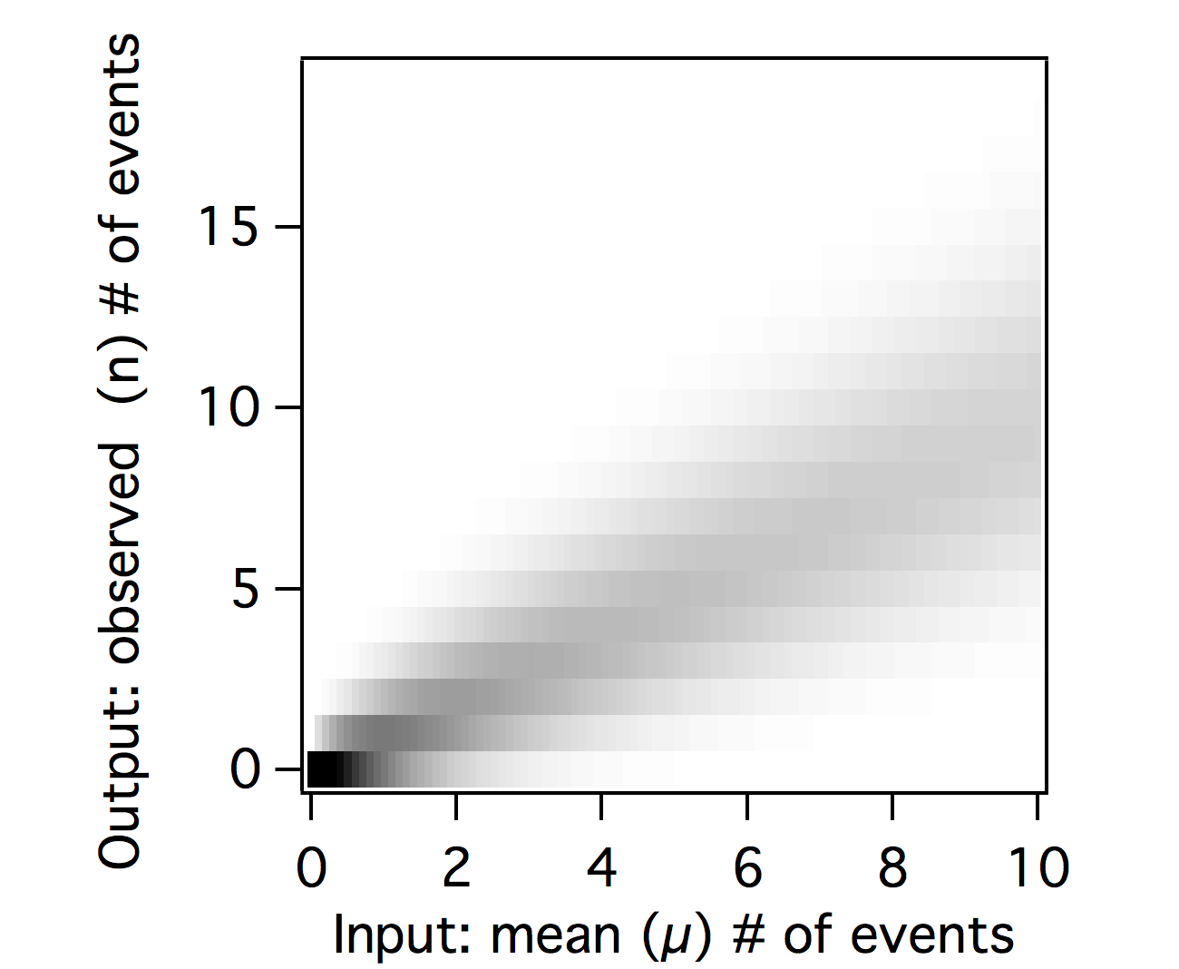
Events with Poisson statistics
µ = mean # of events in a time interval
n = events in a time interval
Joint probability distribution P[n,µ]
Expected frequency
# of events
variance=mean=µ
Notes:
How to think quantitatively about the noise? A common model of variability is the Poisson distribution, which occurs when events occur at an average rate, and with an independent probability during each time interval. i.e. one event doesn’t influence the occurrence of another. Photon arrival is described by a Poisson distribution.
In a Poisson distribution, if there are n events occurring on average, the variance is also n, and the standard deviation is the square root of n.
For example, if a cell whose spiking following a Poisson distribution fires on average at four spikes per second, then the standard deviation is 2 spikes per second. But a cell that fires at 400 Hz has a standard deviation of only 20 spikes per second. So there are significant gains when a signal is carried by many independent elements such as channels or vesicles. But there is diminishing returns, because the variability only decreases by the square root of n.
Not all variability is Poisson. Some are more Gaussian, some are more complicated because events are not independent. For example, because of the refractory period, if a cell fires a spike, its spiking probability changes for some short interval, in contrast to the Poisson distribution. A cell may have Poisson-like spiking at intervals longer than the refractory period.

Slide 7
How to Model Noise?
Poisson distribution Independent events occurring at an average rate.
Photons
Spiking
Gaussian distribution Sum of many independent processes through central limit theorem.
Membrane potential noise
Binomial distribution n independent outcomes, each with probability p.
Channel gating
Vesicle fusion
Approximated by Poisson distribution at low probability p

Slide 8
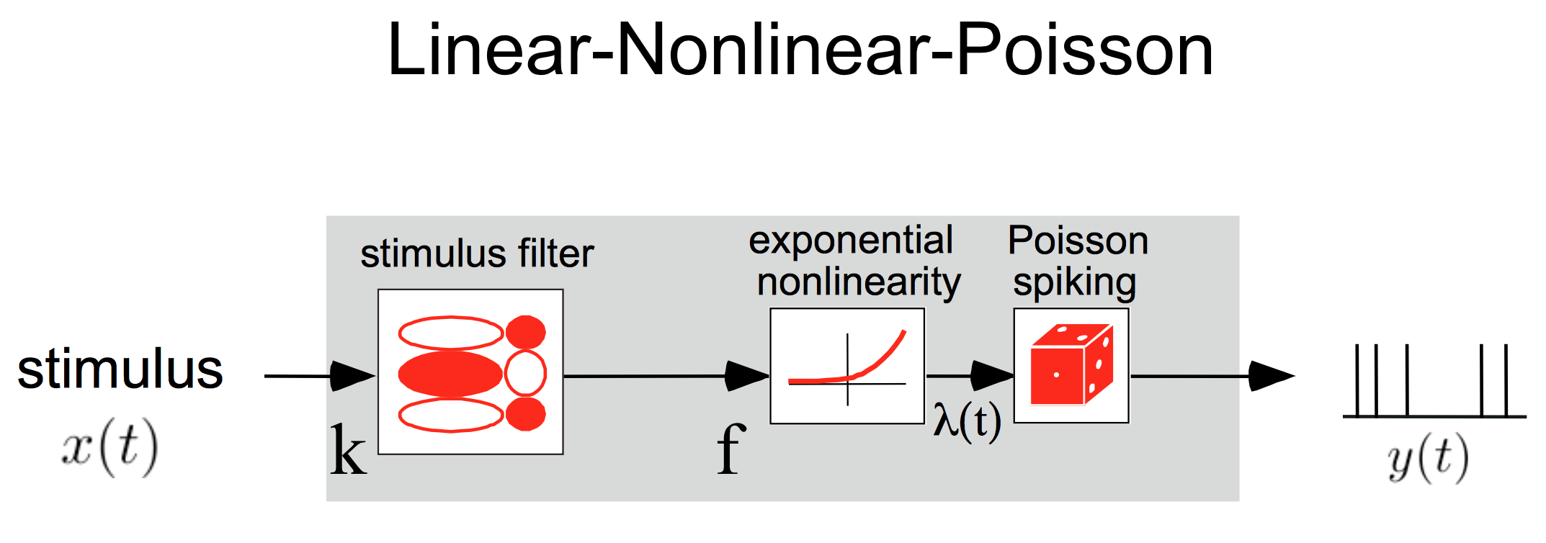
Nonlinearity

Slide 9
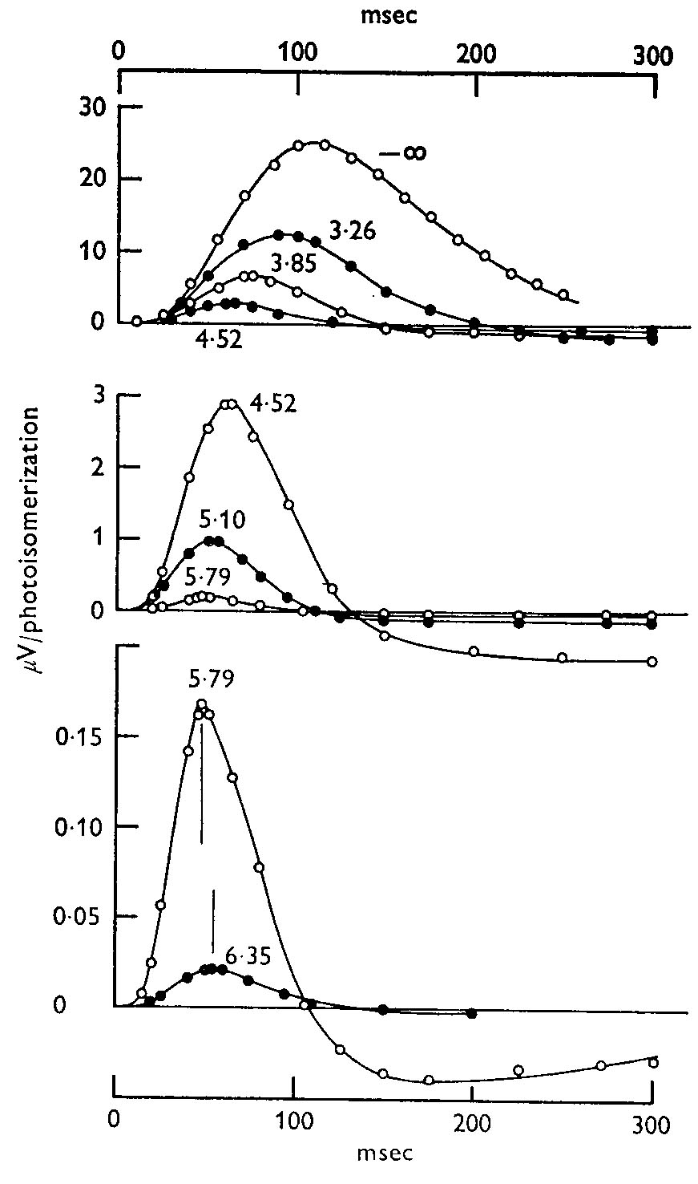
Turtle Cones: Sensitivity and Kinetics change with mean luminance
Dim background
Bright background
Baylor & Hodgkin 1974
Notes:
These curves show flash responses at different background luminances. The responses are normalized to show the response per photon absorbed. The three graphs have a different y-scale. The numbers next to the curves show the log of the background intensity. So the brightest background is 6.35, which has the smallest response *per photon*. In other words, sensitivity is less at brighter backgrounds.
But also notice that at brighter backgrounds, the response is faster and more biphasic.

Slide 10
Signal with poisson distribution
Rate
Filtered
0.1
1
10
100
1000
Notes:
Examples of photons (or another signal) arriving with a Poisson distribution. The signal is a flashing square wave. At the dimmest light intensities, it is very hard to see the step changes because the noise is so great.
Although it is not shown here explicitly, you can see that you can get more temporal information at a higher intensity - I.e. you can see the exact position of the step at a rate of 1000 per time bin (bottom row), but at a rate of 1, it is very hard to tell where the step starts and stops.
Thus the statistics of photons naturally limit the temporal bandwidth at different light levels.

Slide 11
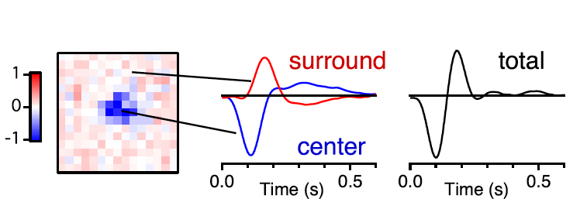
What receptive field maximizes information transmission?
Retinal bipolar cell receptive field
Baccus, Olveczky, Manu & Meister, 2008

Slide 12
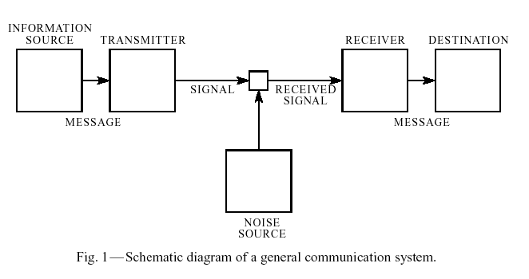
A Mathematical Theory of Communication
Claude Shannon (1948)
Entropy – measure of
uncertainty in bits
Bit – unit of information
Mutual information – What
you can learn about one
signal by observing another
Bell System Technical Journal 27, 379-423
Notes:
Modern information theory was established in a single paper by Claude Shannon

Slide 13
S
R
Joint distribution
Joint distribution
P[R,S]
Marginal
distributions
Marginal
distributions
Notes:
Although the joint distribution holds all information about the combined behavior of two signals (here R and S, for response and stimulus), the joint distribution is only experimentally accessible if the number of responses and stimuli are relatively small.
But in reality, there is a huge possibility of stimuli. If the light intensity on each photoreceptor could only take on two values, and there are 5 million cone photoreceptors in each human eye, then the number of possible stimuli is 2 raised to the power of 5 million. The number of responses can also be large if one considers the possible different patterns over time: 10 bins of time, 2 values yields 2^10 possible responses.
So the full joint distribution is only measurable in simple cases.

Slide 14
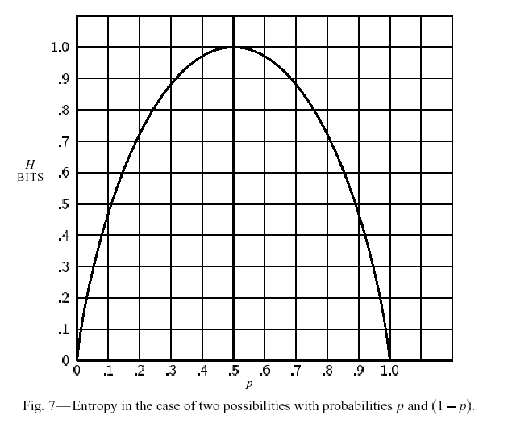
A Mathematical Theory of Communication
Claude Shannon (1948)
What is information?
Entropy*
A measure of uncertainty of a random variable in bits. The maximum possible amount of information there is to be learned from a variable.
Entropy of a fair coin =
- 1/2 log(1/2) - 1/2 log(1/2) = 1 bit
of an unfair coin =
- 3/4 log(3/4) - 1/4 log(1/4) = ~0.8 bits
*By analogy to entropy in statistical mechanics,
k: Boltzmann constant W: Number of possible microscopic states
Notes:
Entropy is also sometimes abbreviated as S() in information theory (like the 97 deRuyter paper).
The specific definition of entropy comes as an answer to a question posed by Shannon. What is a measure of uncertainty of a probability distribution (a set of outcomes) that is;
Additive – If you split a the number of possible outcomes of a variable X into two parts, X1 and X2, then H(X)=H(X1)+H(X2). But if number of possible outcomes (states) of X1 is x1, and the number of possible outcomes of X2 is x2, then the number of possible outcomes of X is x1 times x2 (not x1 + x2). Because of this, the additivity condition gives rise to the log, because log(a+b)=log(a)*log(b).
Symmetric – If you switch around the states of the system, the entropy should be unchanged.
Continuous - if you make a small change in the probabilities of X, you make a small change in the entropy.
Maximum – The measure reaches a maximum when all outcomes are equally likely (like when a coin is fair).
Shannon showed that there is a unique measure, which is – Sum p(x)log(p(x)).

Slide 15
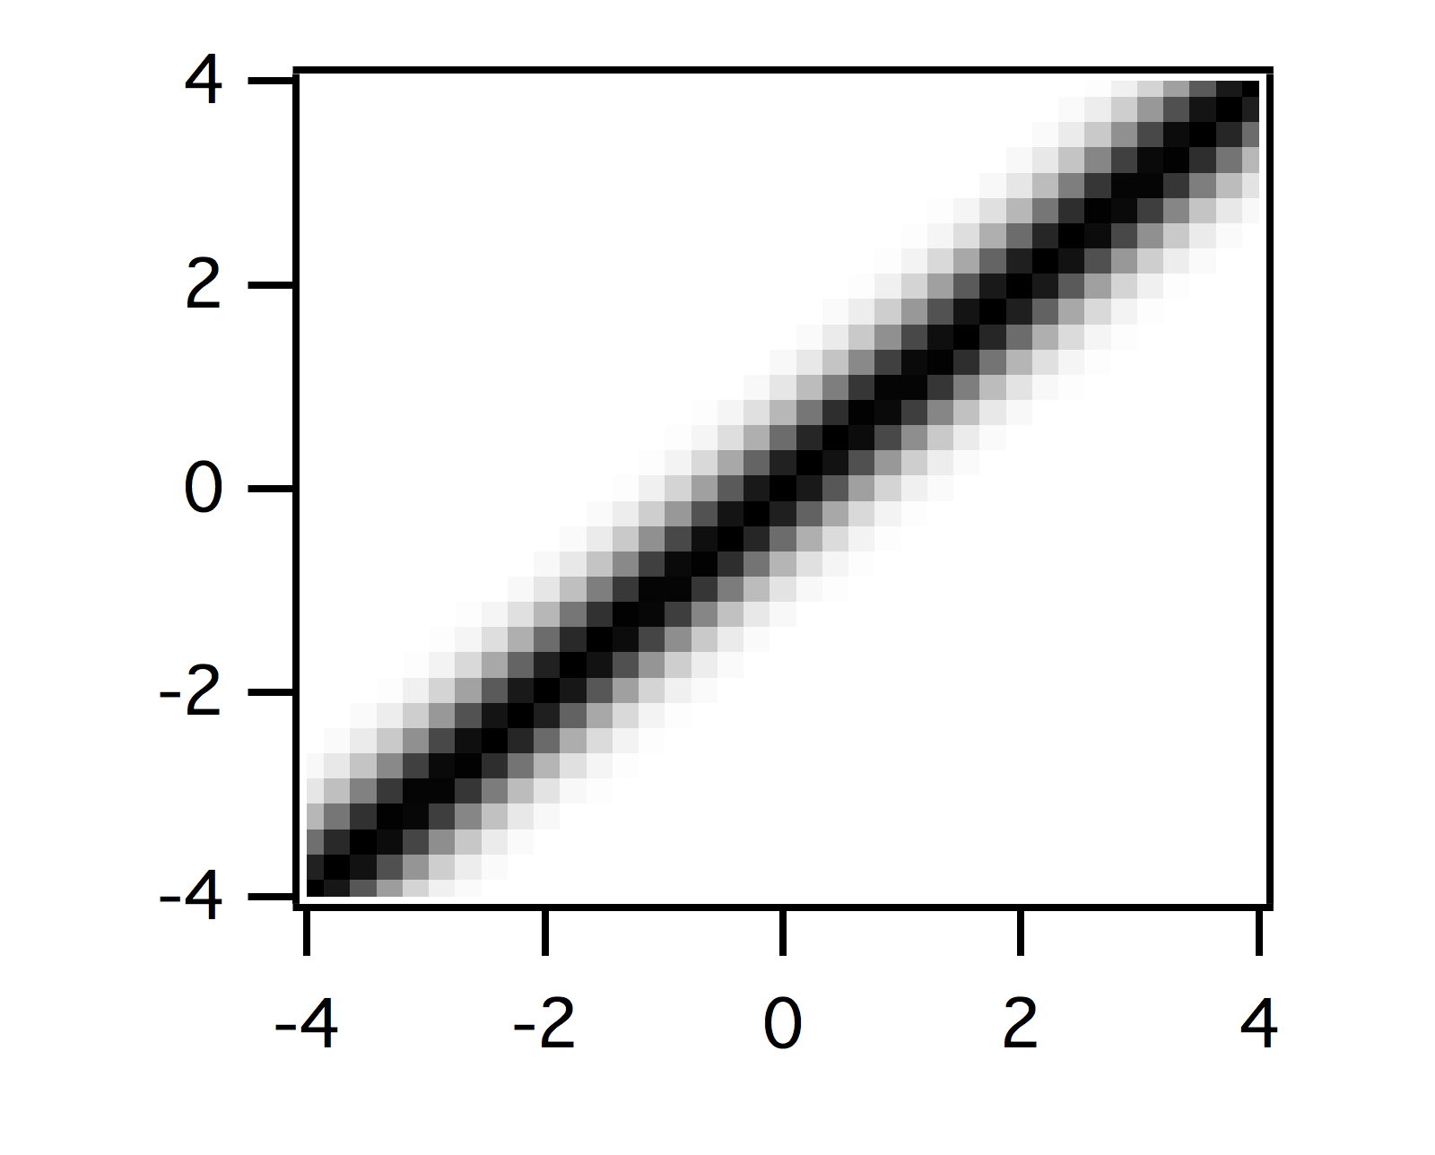
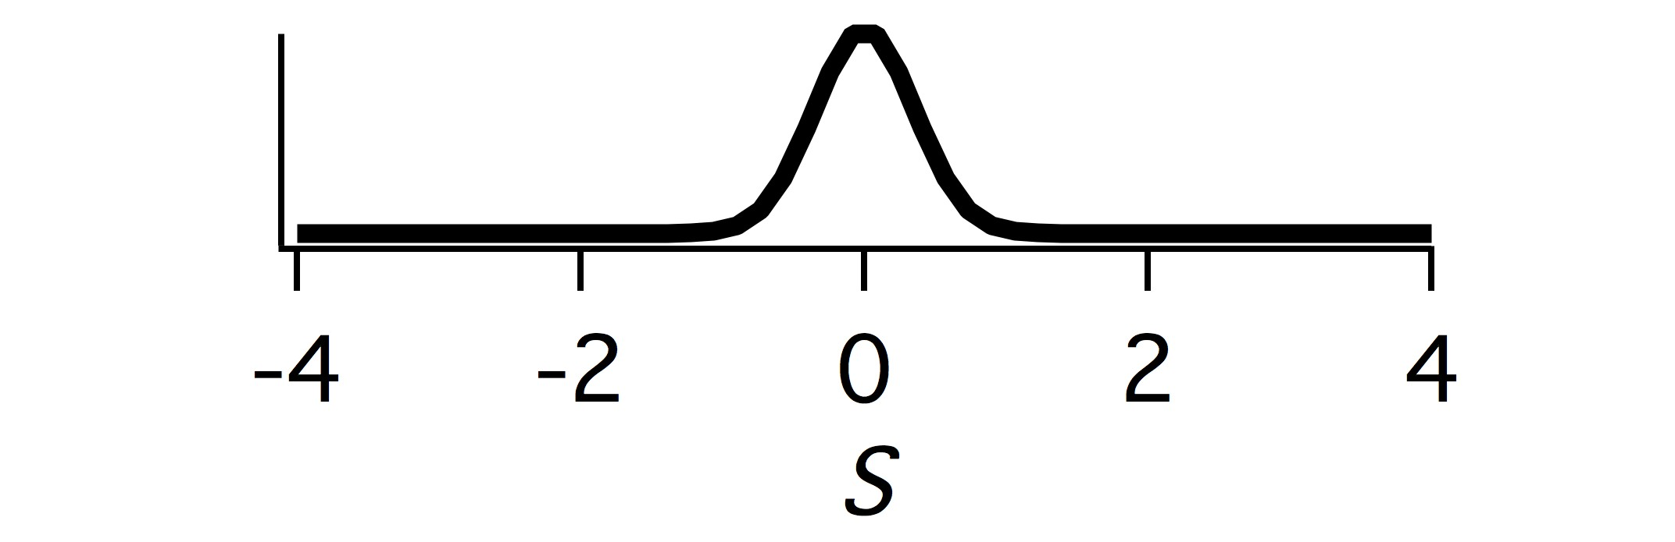
Information is a reduction in entropy
Conditional distribution
R=0
Conditional entropy
Mutual information
A measure, in bits, of how much information is conveyed by one random variable about another random variable. It is equal to the entropy minus the conditional entropy.
Notes:
So how can the entropy be used? Since entropy indicates uncertainty, a reduction in uncertainty represents information. This can be seen through the conditional distribution P[S|R], read ‘P of S given R’, which is equal to the probability of S once you know what R is. This is the joint distribution P[R,S] normalized by the marginal P[R]. Thus all the rows in the graph at top right sum to one. You can see that once you know what R is, the level of uncertainty decreases.
The measure called the conditional entropy tells about the uncertainty once you know the value of R. It has the log term again like entropy, but it is the log of the conditional distribution. Note also that it is not Sum (P[S|R]logP[S|R]), it is weighted by the original joint distribution.
We can then define a measure of information as the reduction in uncertainty that measured as the difference between the entropy of a variable S, and the conditional entropy once you know another variable R.
Mutual information is symmetric, so the information in S about R is the same S the information in R about S. This means that there is no causal element considered in this relationship. Whether X caused Y or Y caused X or Z caused both of X and Y, I(X;Y) is the same.

Slide 16
Mutual information as the ‘distance’ between two probability distributions
Product distribution – what things would
Look like with zero information
P[R]P[S]
Notes:
There’s another way to think about and calculate mutual information as the ‘difference’ or ‘distance’ between the actual joint distribution and the distribution of the two variables had no information about each other.
The essence of this equation is a weighted ratio between the two distributions shown at the top.
The left joint distribution is what actually happened P[X,Y] (stated P of X and Y). The right distribution is what would have happened had P[X] and P[Y] been the same, but the two signals were completely independent - in other words carried zero information about each other. This is sometimes called the Product Distribution. The two equations for mutual information give the same result.

Slide 17
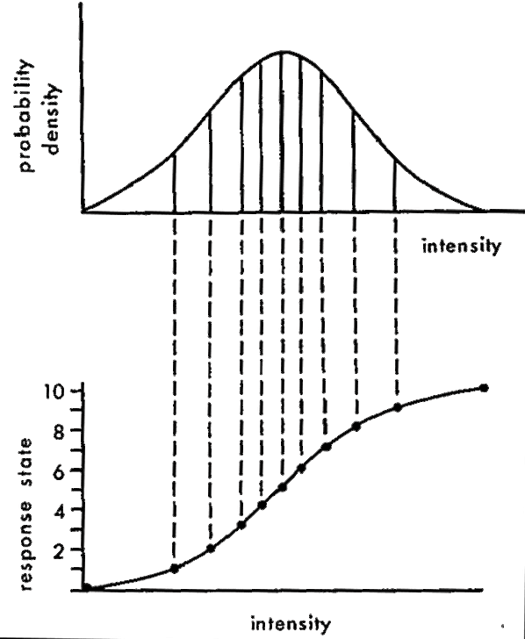
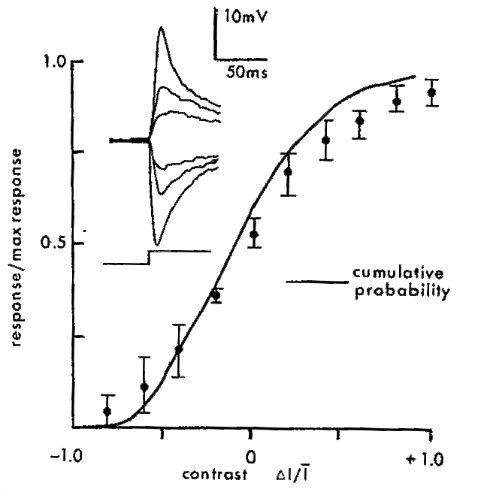
What is the optimal nonlinearity?
Simon Laughlin, A simple coding procedure enhances a neuron’s information capacity Z. Naturforsch, 36c: 910-912 (1981)
Notes:
Simon Laughlin proposed a simple theory of how a cell should match its response curve to a distribution of intensities. The upper left graph shows a hypothetical probability distribution of light intensities. The response curve that transmits the most information about particular sampled intensities is shown below. It looks like the integral of the intensity distribution.
At right shows the actual response curve for a fly neuron responding to changes in intensity. The x-axis indicates the change in intensity divided by the mean intensity (delta I / I) or the contrast. The dots show a measured response curve of an adapted fly neuron, and the smooth curve is the integral of the intensity distribution used to adapt the photoreceptor.

Slide 18
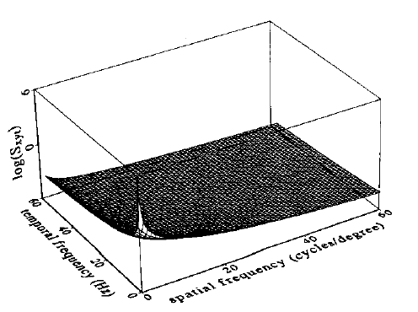
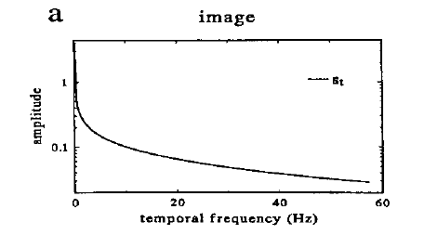
Theory of maximizing information in a noisy neural system
‘Efficient Coding’ - Horace Barlow
Natural visual scenes are dominated by low spatial and temporal frequencies
J.H. van Hateren. Real and optimal neural images in early vision. Nature 360:68-70 (1992)
J.H. van Hateren, Spatiotemporal contrast sensitivity of early vision. Vision Res., 33:257-67 (1993)
Notes:
Very interesting work by Hans van Hateren has attempted to derive a number of response properties of the early visual system directly from the statistics of natural scenes.
In the model at left, a system receives an image that has noise it in, mainly due to photons (1st added noise). Then, a “neural filter” transforms the input. What this neural filter really means is a temporal and spatial receptive field. Then afterwards a source of intrinsic noise is added (2nd “channel noise”), which might be variability is spiking or in vesicle release, or many other mechanisms.
The effect of this 2nd added noise is that no matter what happens, there is a maximum signal to noise ratio (SNR) that the channel (cell) can have, and it can’t do any better than this. So if the light intensity is very bright (high SNR), and the first noise has a small effect, the 2nd noise will be limiting. But if the light intensity is dim (low SNR) the first noise will be limiting.
The graph at right shows the switch between these two regimes, and gives a equation to describe this change in regimes. The square root of I (light intensity) in the denominator is the photon Poisson noise.

Slide 19
Linear filter and frequency response
Stimulus
Filter
Response
Convolution theorem
a convolution in the time domain
is a simple product in the frequency domain
Notes:
The ~ (there are also other notations) indicates Fourier transform, which transforms a signal that has a different amplitude at each time point into a sum of sinusoids that has different amplitude and phase for each frequency sinusoid. To find the amplitude at each frequency in the response, take the amplitude of that frequency in the stimulus, and multiply it by that frequency in the filter. The convolution theorem implies that to compute a convolution of two functions like f() and g(), you can first take the Fourier transforms of f() and g(), multiply the result for each ω of f(ω) and g(ω), then take the inverse Fourier transform of the result. For these purposes, you don’t need to know how to compute a Fourier transform, just what it means, and that there is an inverse.

Slide 20
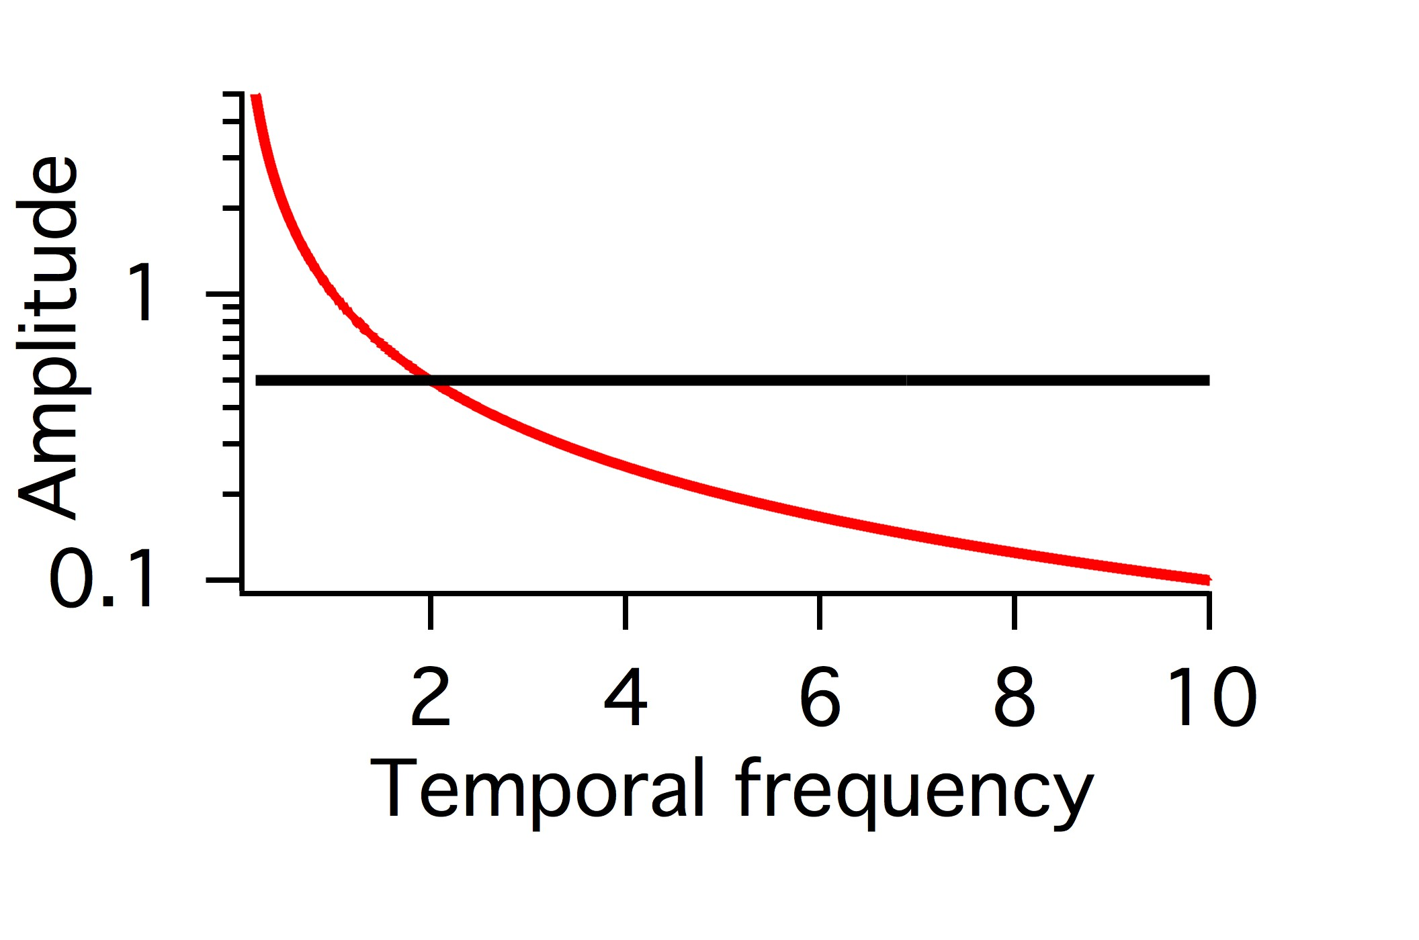
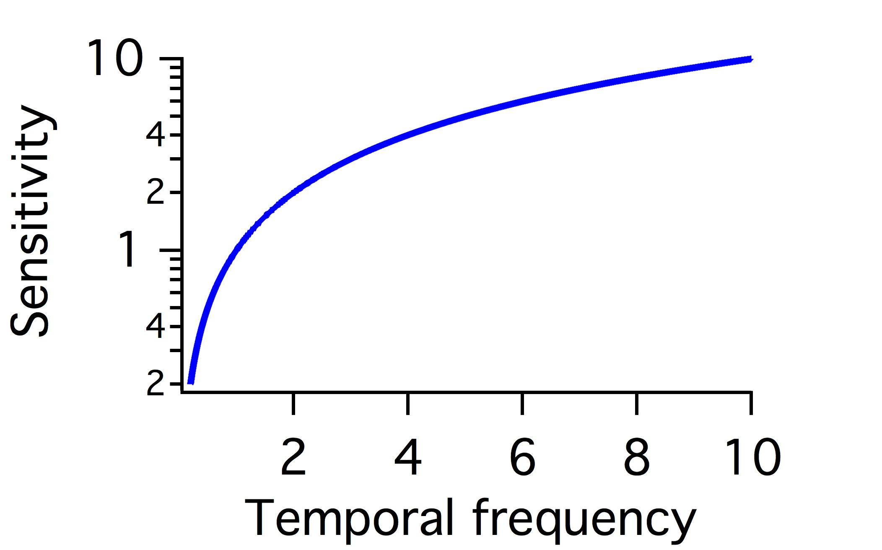
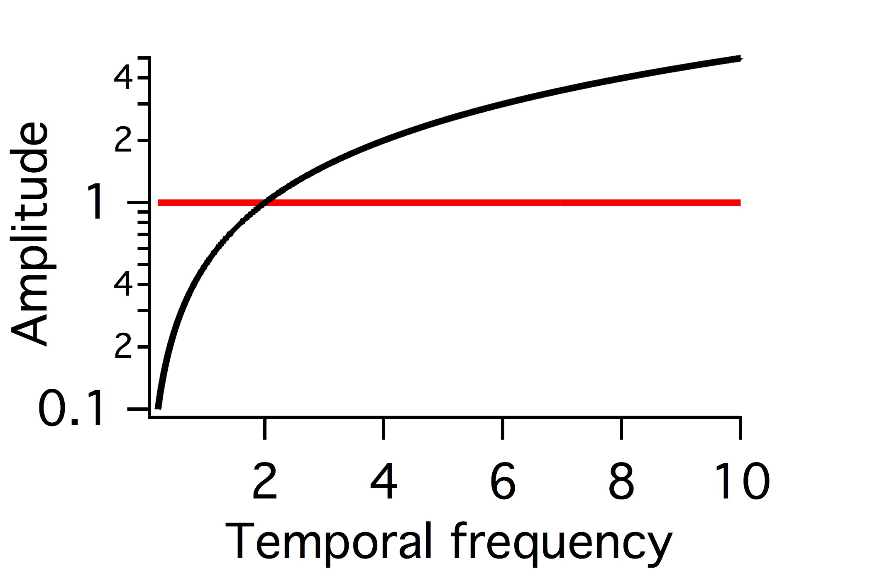
Optimal filter whitens but also cuts out noise
Stimulus
Noise
1/f
‘Whitening’ filter
Filter
Response
Noise
Notes:
These diagrams show the concepts of optimal filtering discussed in the Van Hateren paper. An efficient system will use all
Symbols with equal frequency. Remember the entropy diagram of the coin that had a peak in the middle. Entropy had a peak
When heads and tails at equal probability. This meant that the amount of information that such a signal could convey had a peak when the two
Symbols had equal probability.
Thinking in terms of temporal frequencies as different inputs and outputs, if a stimulus has more low frequency, it is efficient to ‘whiten’ the output,
Making the response use different frequencies equally. Whitening is accomplished by having a filter that is inverse of the stimulus.
Because a convolution is a produce in the frequency domain, if the Stimulus frequency spectrum is proportional to 1/f, then the optimal filter should be proportional to f.
This discussion however, does not consider the noise. In this case, the noise is equal at all frequencies. Therefore, when passed through a filter that is proportional to f, emphasizing high frequencies, at some point noise becomes greater that the signal represented in the response. Thus it is also the best solution to simply cut out these higher frequencies, because the noise is too great. Thus the optimal filter will have a bandpass appearance, both reducing low and high frequencies.
This situation depends on how great the noise is. When the amount of signal that is above the noise is very small, then it no longer is efficient to reduce the only signal that is available. In this case, a low pass filter that reduces only high frequencies is more efficient (not shown here).

Slide 21
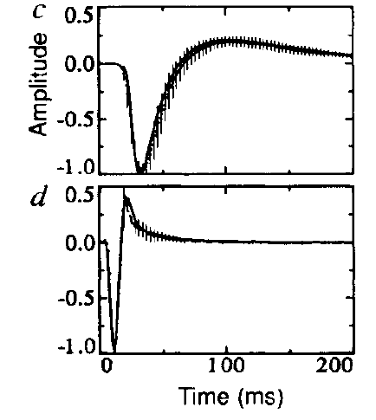
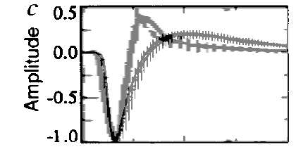
Theory of maximizing information in a noisy neural system
Filter of fly Large Monopolar Cells, 2nd order visual neuron
Low background intensity
Integrates over time
(real and theoretical optimum)
High background intensity
Emphasizes change, is more differentiating
(real and theoretical optimum)
Both, scaled in time to the first peak
J.H. van Hateren. Real and optimal neural images in early vision. Nature 360:68-70 (1992)
Notes:
Using the theory and statistics of natural scenes outlined on the previous slides, the optimal temporal filter can be derived, and it looks very close to the actual filter of a fly 2nd stage neuron. The smooth curve is the derive temporal filter, the vertical lines indicate error bars on the measured filter. At low light intensities, the filter is slower and more monophasic. At high light intensities, the filter is faster and more biphasic. The bottom graph shows the two stretch in time and superimposed to show that the faster filter is more biphasic.

Slide 22
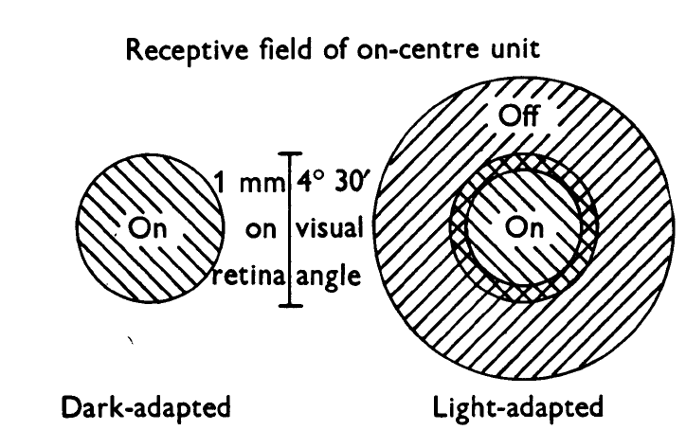
Spatial adaptation in retinal ganglion cells
Barlow, Fitzhugh & Kuffler (1957)

Slide 23
Theories of efficient coding:
An ideal encoder should use all output values with equal probability
Low frequencies dominate in natural scenes
An efficient encoder should amplify higher frequencies more than low frequencies
But when signals are more noisy, such as when the signal is weak, higher frequencies should be reduced, as they carry little information

Slide 24
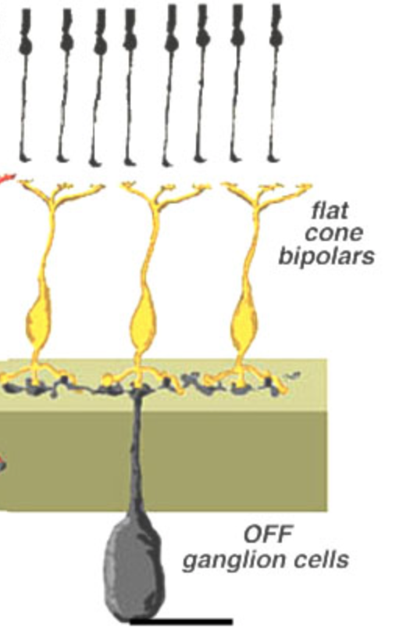
A Simple Model of Visual Responses
Linear-Nonlinear (LN) Model
Receptive Field
Spatiotemporal
Filter
Cone
Synaptic
weights
w₁
w₂
w₃
Bipolar cell
Time
Preferred
Visual feature
Ganglion cell

Slide 25
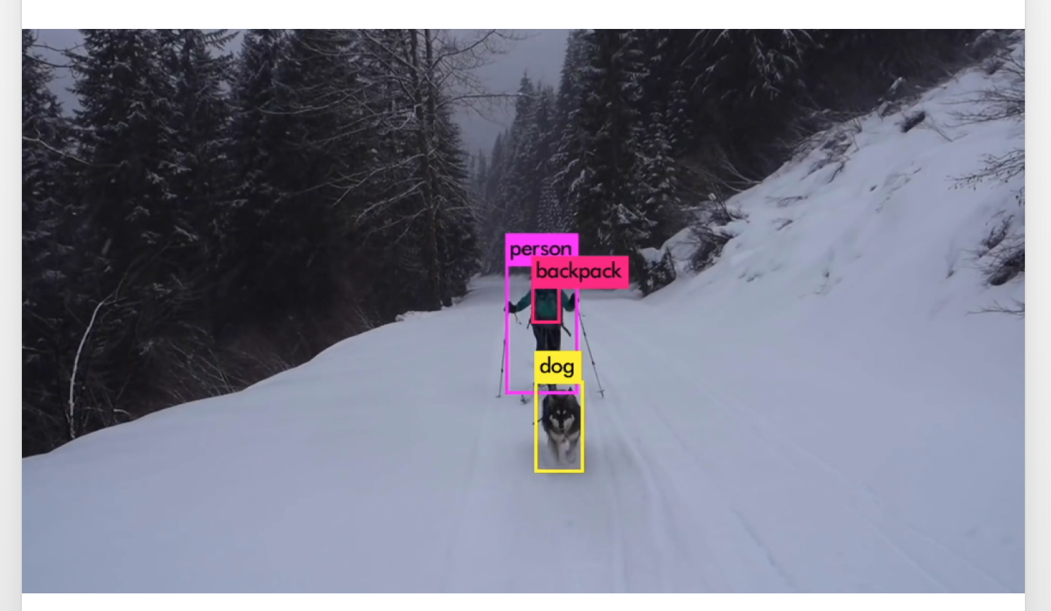
Deep Learning Object Recognition

Slide 26
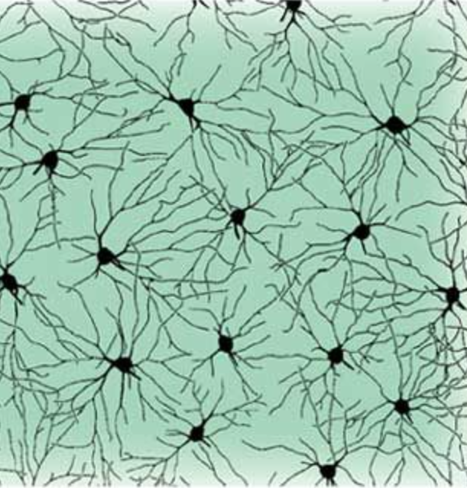
“Convolutional” layer
Like a mosaic
of retinal neurons

Slide 27
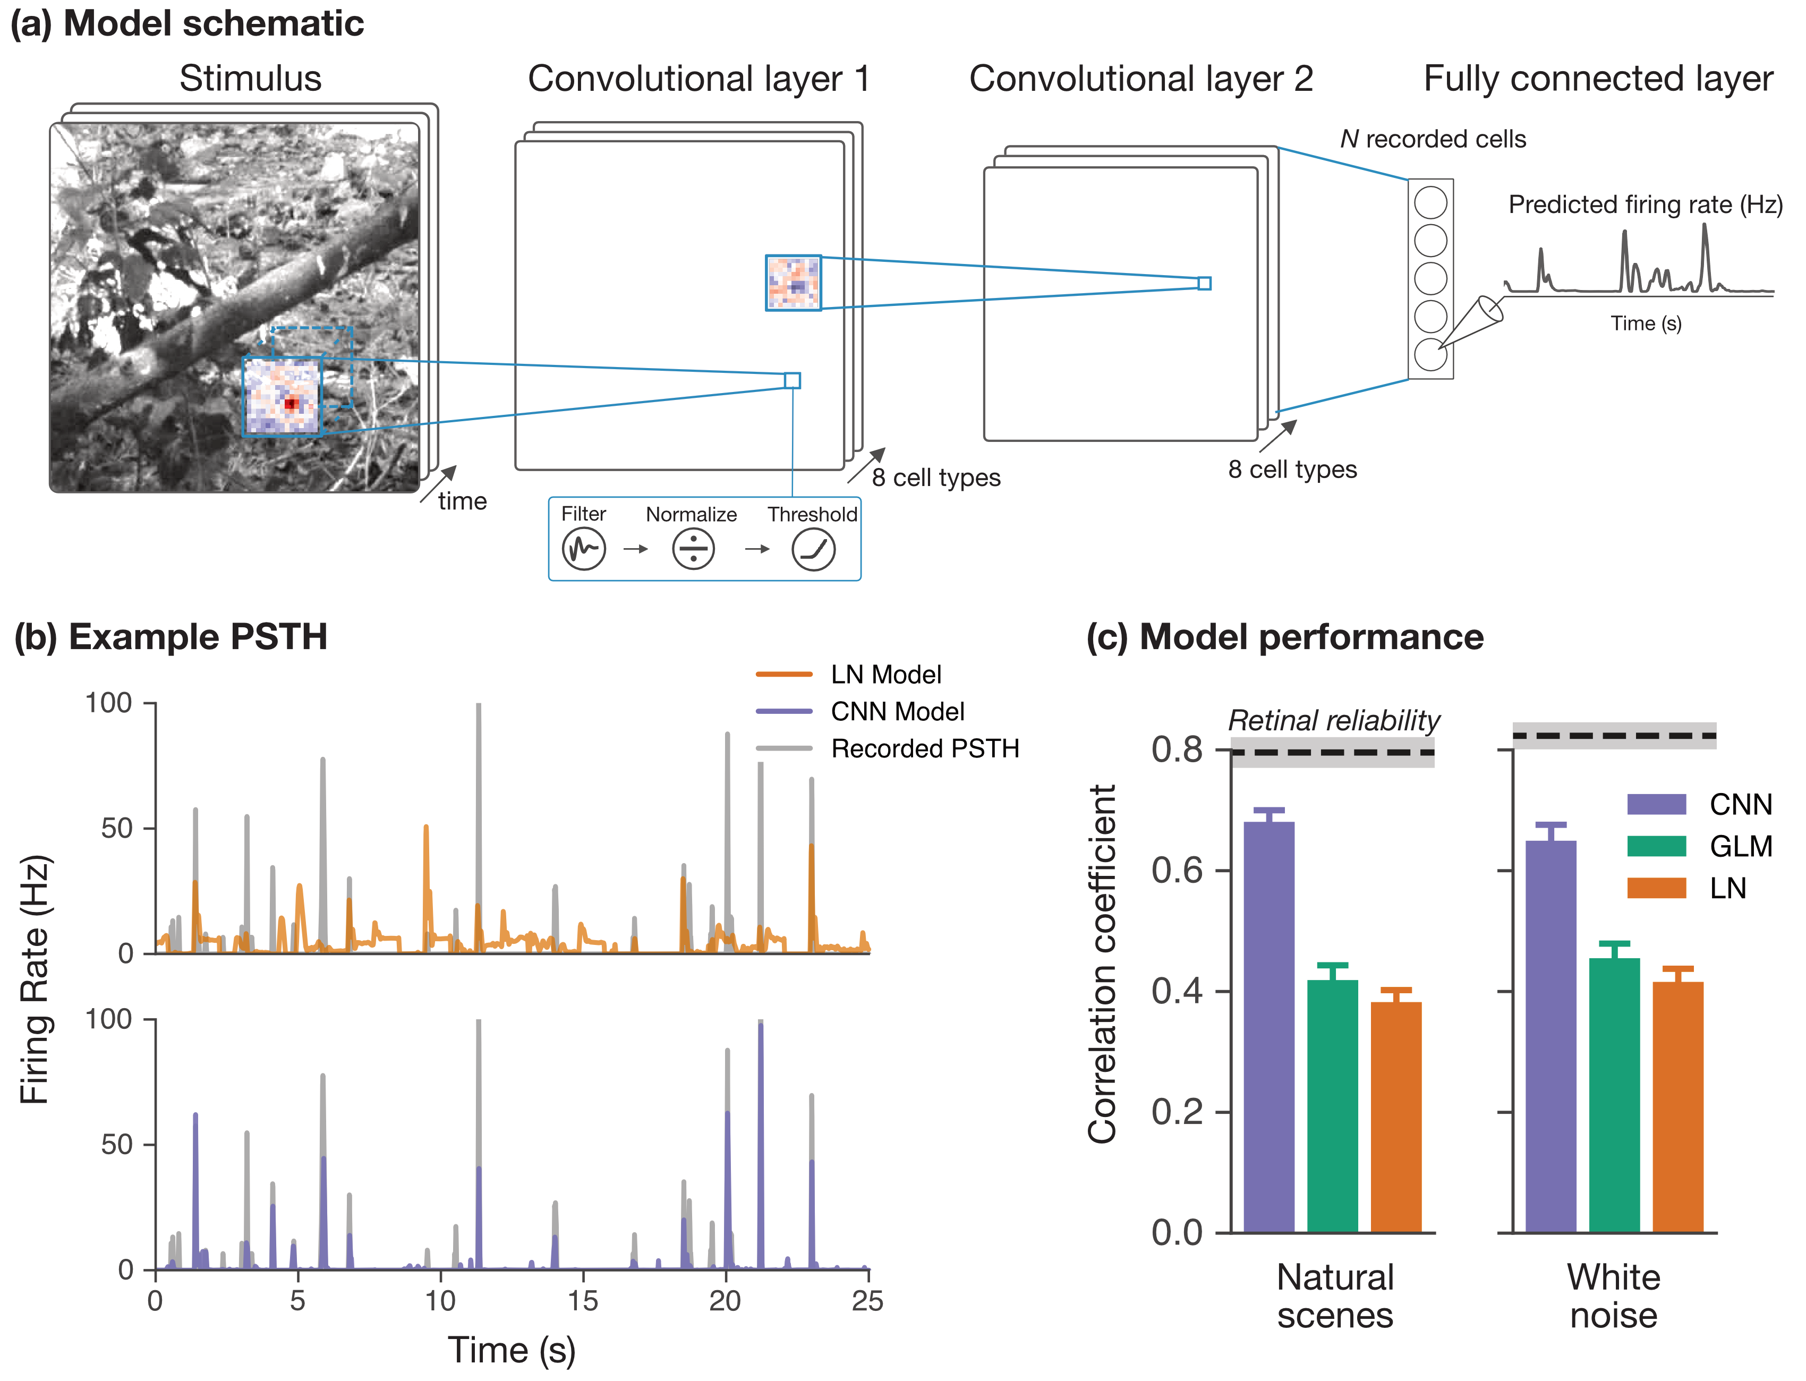
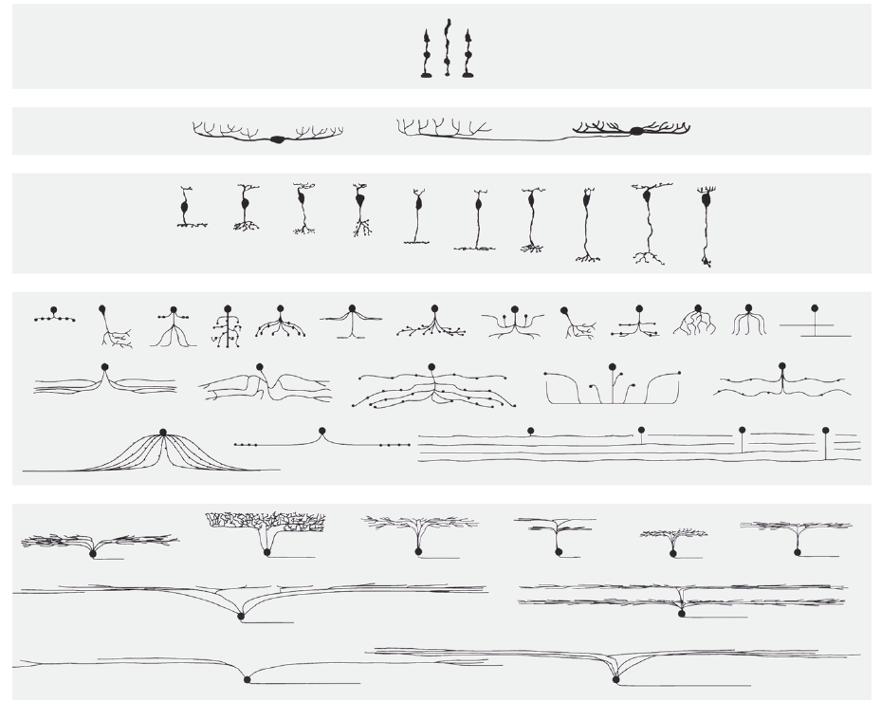
Multiple cell types
A
Multiple
cell types
Filter Scale Threshold
Like the multiple cell types in the retina
L

Slide 28
Multiple Layers
A
Multiple
cell types
Filter Scale Threshold
L
Like the multiple cell types in the retina
Like the hierarchy of retinal circuitry

Slide 29

Object Recognition Deep Network

Slide 30
Different sensory models
for different questions

Slide 31
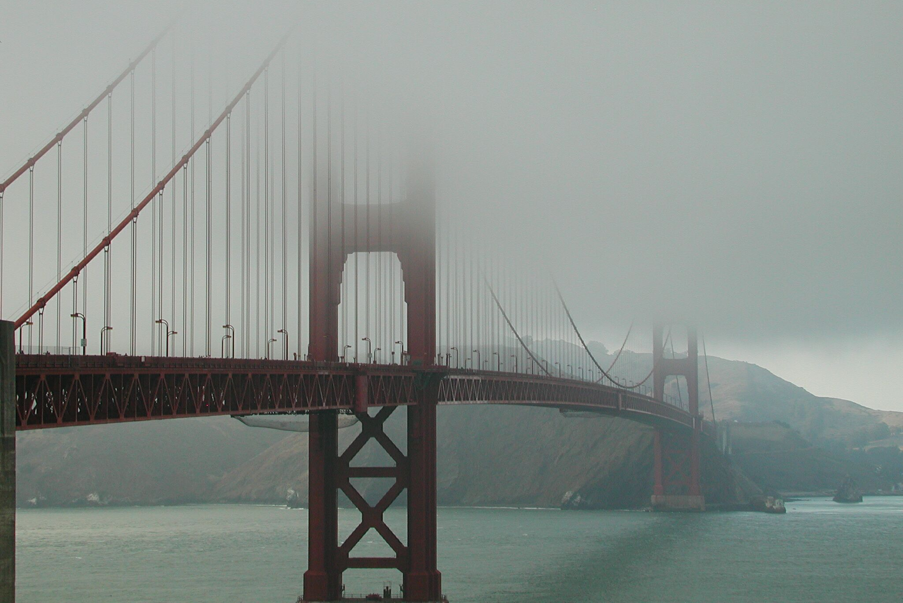
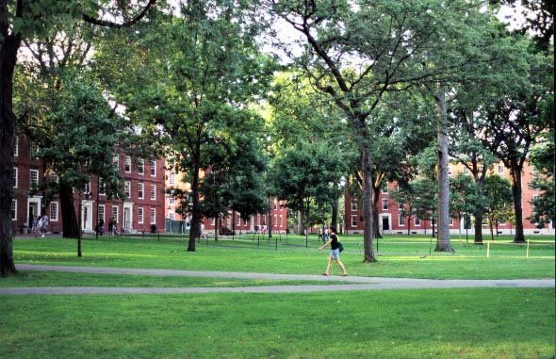
Adaptation to mean and variance
Intensity
Notes:
Even at a constant mean light intensity, the visual system will change its sensitivity to fluctuations in light intensity. That make sense, because as we discussed, beyond bipolar cells, what the visual system encodes is mainly changes (due to the biphasic bipolar cell filter) not the absolute intensity. When the changes in intensity become too large, a cell may saturate. So it is beneficial for cells to adjust their range of response to the range of light intensities, even if the mean doesn’t change.

Slide 32
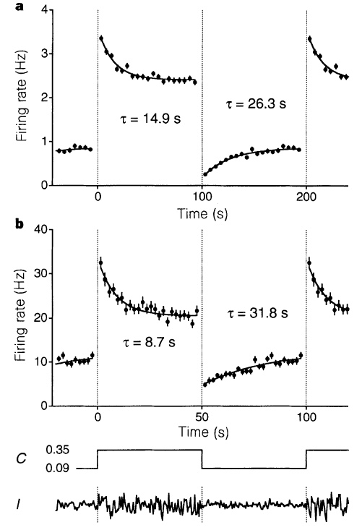
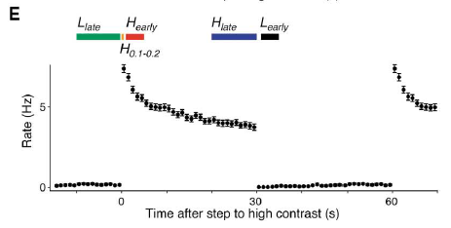
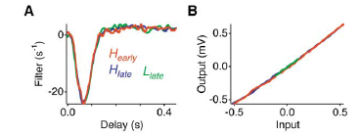
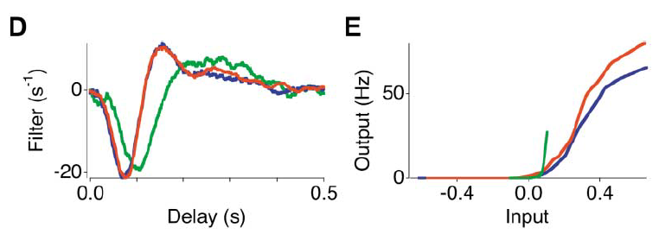
Photoreceptor
Filter
Nonlinearity
Ganglion cell
Baccus & Meister. Fast and slow contrast adaptation in retinal circuitry. (2002).
Notes:
The same type of experiment as the Smirnakis paper. Here, the data was analyzed by calculating a model of the response at different times following a change in contrast as a way to assess how adaptation changes the encoding of the stimulus.
H-early: Just after a step to high contrast.
H-late:After prolonged adaptation to high contrast.
L-early: just after a step to low contrast.
L-Late: After prolonged adaptation to low contrast.
Fast contrast adaptation: Ganglion cells change their temporal response filter at high contrast by becoming faster and more biphasic. Also at high contrast, the nonlinearity becomes less steep, showing that the cell is less sensitive.
Slow contrast adaptation: After prolonged adaptation to high contrast, the nonlinearity threshold moves a bit higher and the slope decreases a bit.
The fast adaptation looks very similar to light adaptation in cone photoreceptors from the Baylor & Hodgkin paper. The two results can both be thought of at adaptation to different signal to noise ratios. At high SNR (high contrast, luminance) the responses were faster, more biphasic, and less sensitive. At low SNR (low contrast or luminance) the response were slower, more monophasic, and more sensitive.

Slide 33
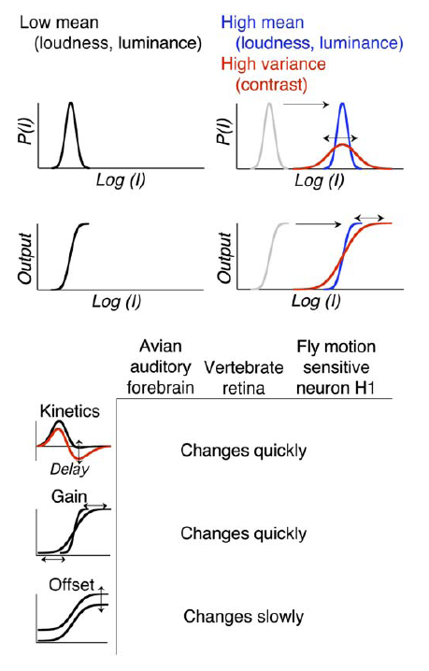
Notes:
Similar types of adaptive properties in very different systems. In the avian forebrain, vertebrate retina, and fly motion sensitive (H1) interneuron, response kinetics change quickly following a change in mean or variance.
Gain (sensitivity, slope) changes quickly.
Whereas, the offset, baseline firing rate - or the threshold - changes slowly.
Human perception also has similar characteristics, from the Adelman paper in an earlier slide.

Slide 34
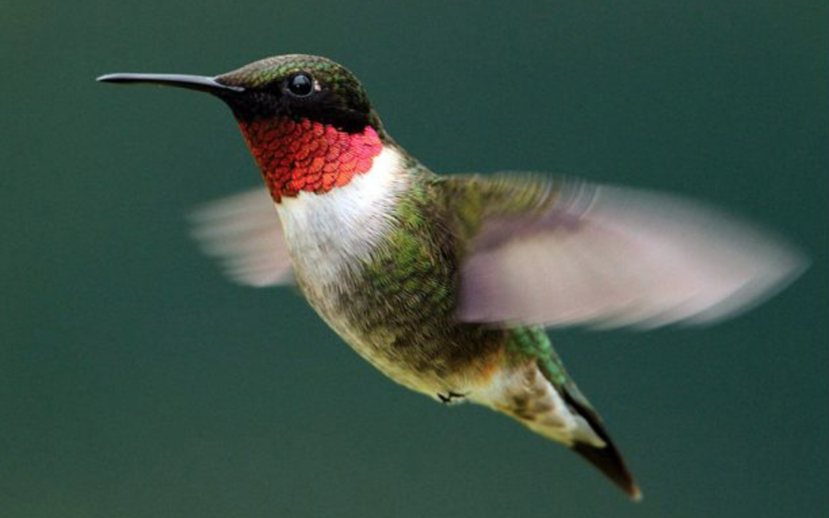


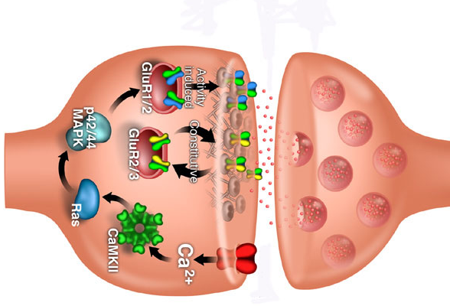
Why study biophysical mechanisms?
Biophysics provides constraints
Biophysics provides a tool kit
Function
Mechanisms
Higher level
function
Computations
Theory
Lower level
mechanisms

Slide 35
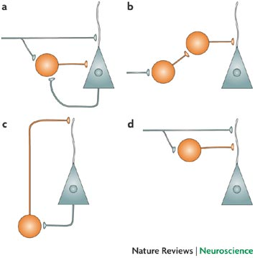
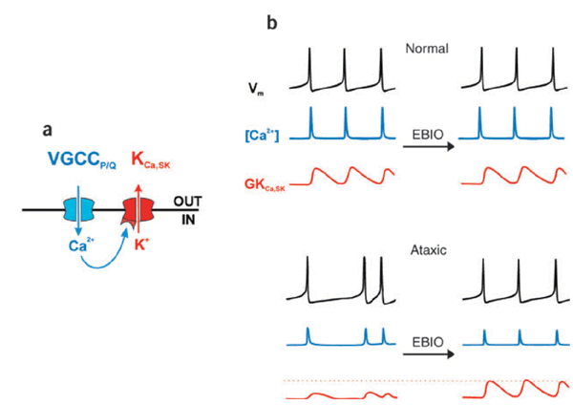
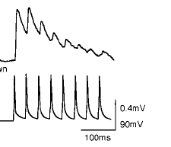
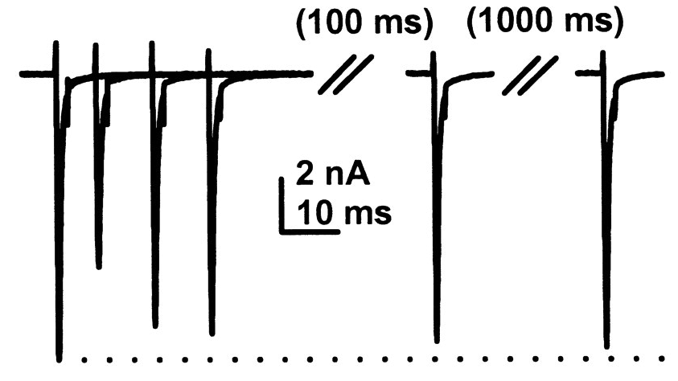
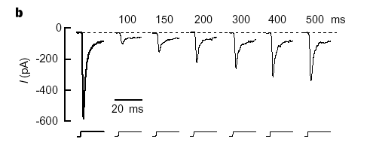
Change in sensitivity by modulation
Feedforward inhibition
Feedback inhibition
Spike dependent conductances
Change in sensitivity by depletion
Ion channel inactivation
Short-term synaptic plasticity
synaptic depression
Receptor desensitization
Post
Pre

Slide 36
‘Equivalent’ circuit model of a neuron
I_{K}
I_{c}
Inside
G_{K}
V
C
E_{K}
I_{e}
Outside
+

Slide 37
A mathematical model of a neuron
Spike
generator
g_{Na}
g_{K}
g_{L}
V
C
+
E_{Na}
E_{K}
E_{L}
I_{e}
+
+
Alan Hodgkin
Andrew Huxley, 1952

Slide 38
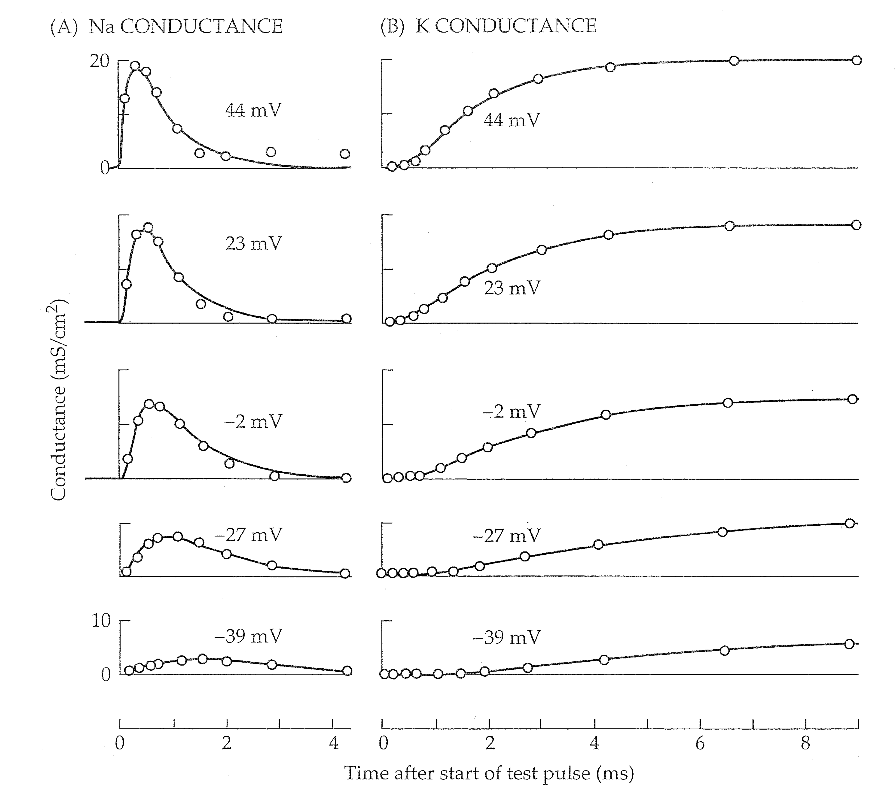
Ionic currents (Time dependence)
activation
activation
inactivation
Time after start of pulse (ms)
Time after start of pulse (ms)

Slide 39
Rate constants
Closed
Open
State
Occupancies
(sum to 1)
R
A
Change in
activity = Inflow – Outflow
Kinetic model

Slide 40
Input and output in a kinetic model
Closed
Open
R
A
Active
Resting
[L]k_{on}
k_{off}

Slide 41
Steps for computing the model, focusing on K+ current:
Max cond.
state variable
Closed
Open
1-n
n

Slide 42
Steps for computing the model, focusing on K+ current:
Closed
Open
1-n
n
Start with at time step t
Compute rate constants as a function of
Compute and integrate one time step to get
Compute K current:
Compute total membrane current:
Integrate to get at next time step

Slide 43
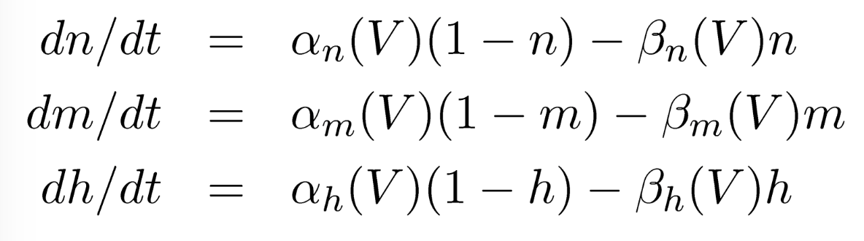
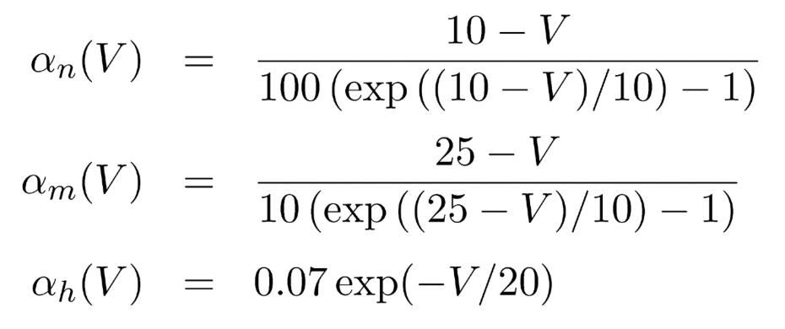
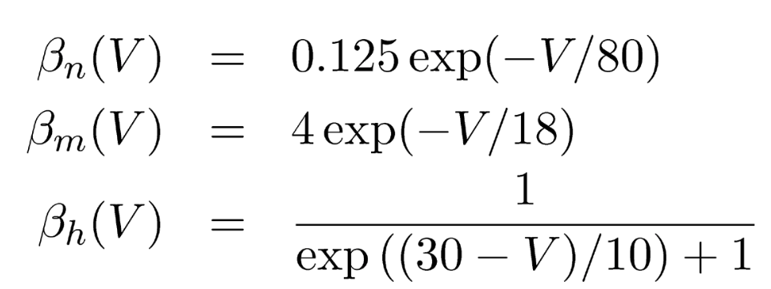
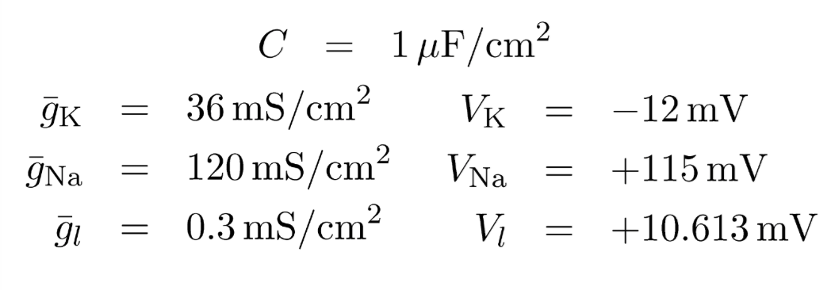
Hodgkin Huxley Model
Voltage state variable (membrane equation):
Conductance state variables:
Rate “constants”:
Constants:
Note: these are given in
the original form,
relative to V_{rest} =~ -66 mV

Slide 44


Slide 45
Adaptation to the mean and variance of signals are similar in a number of systems
The kinetics and gain of the response change when the stimulus statistics change
These adaptive properties can be interpreted as avoiding
saturation and maximizing information in the
presence of noise
Many mechanisms can contribute these adaptive nonlinear
properties at different timescales

